Slide 1
Festival of Lights
Technical Teach In
5/11/2021

Slide 2
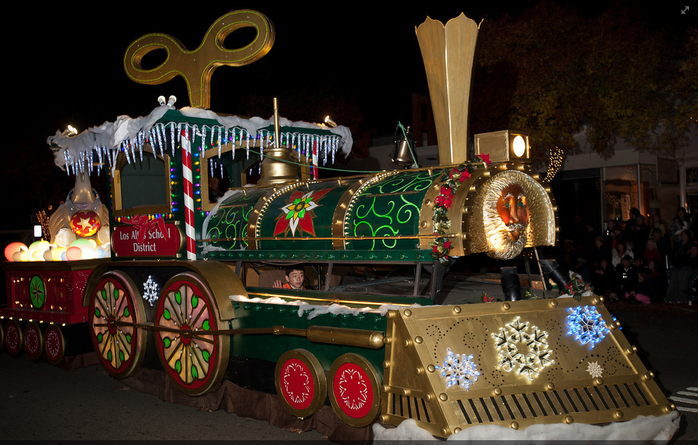
Agenda
Sound Systems
Jingle Bell Rock
DMX

Slide 3
Sound Systems
https://drive.google.com/drive/folders/1v5zLXFOrcpogjYSqEk8hEICQRdYDcKUj?usp=sharing

Slide 4
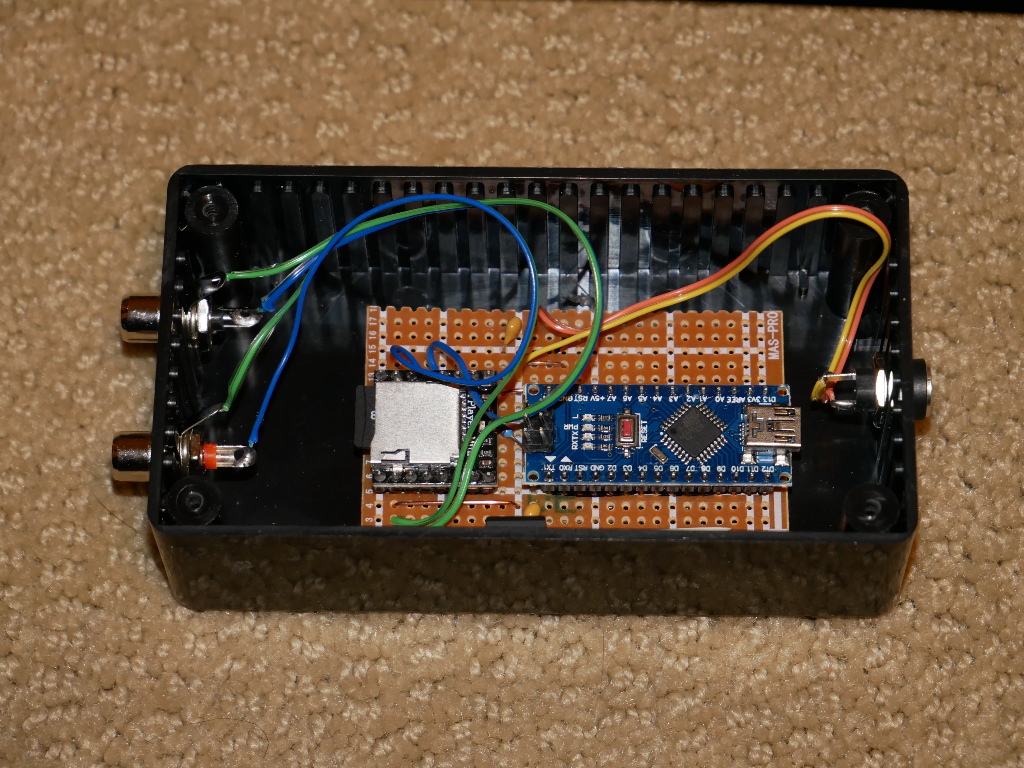
Hardware
Arduino Nano
DFPlayer Mini
TF/Micro SD card
5v regulator
1k resistor
Breadboard

Slide 5
Bill of Materials
Qty Reqd | Description | Supplier | Unit cost | Total cost
1 | KOOKYE 5PCS Nano V3.0 ATMEGA328P Module CH340G 5V 16M Mini USB Micro-controller Board for Arduino(Nano5) | Amazon | $3.80 | $3.80
1 | 4GB MicroSDHC Memory Card | Amazon | $8.00 | $8.00
1 | 12VDC 1A Wall Adapter Power Supply | Amazon | $4.89 | $4.89
1 | 1K Ohm 1/8 Watt 1% Metal Film Resistor | Amazon | $0.11 | $0.11
1 | Hook and Loop Tape Roll Self Adhesive Strips Sticky Back Fastener, 1In wide Black | Amazon | $0.12 | $0.12
1 | L7805CV Positive Voltage Regulator Output 5v TO-220 Package | Amazon | $0.35 | $0.35
1 | DAOKI U Disk Mini MP3 DFPlayer Player Module Audio Voice Board | Amazon | $3.20 | $3.20
1 | HAMMOND 1591CSBK ENCLOSURE, MULTIPURPOSE, ABS, BLACK | Amazon | $6.72 | $6.72
1 | Premium Dual 1/4 Inch To Dual RCA Audio Cable (3FT) - Male 6.35mm 1/4" Phono Mono to RCA Connector Wire Cord Plug Jack | Amazon | $7.99 | $7.99
2 | Metal Panel Mount RCA Female Socket Connectors Adapter 20 Pcs Silver Tone | Amazon | $0.41 | $0.82
1 | 70mm x 90mm Welding Soldering Copper Strip Prototype PCB Printed Circuit Board Stripboard | Amazon | $1.00 | $1.00
1 | SINNRY 10 Pcs 5.5mm x 2.1mm DC Power Socket Female Threaded Mount Connector Adapter | Amazon | $1.40 | $1.40
 |  |  | Total | $36.99

Slide 6
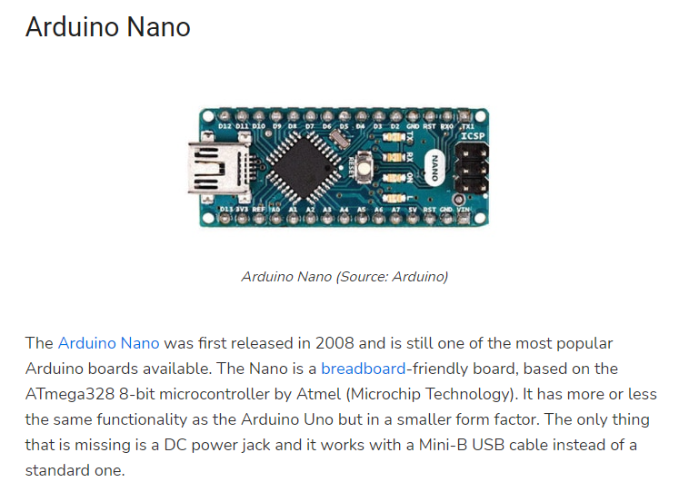
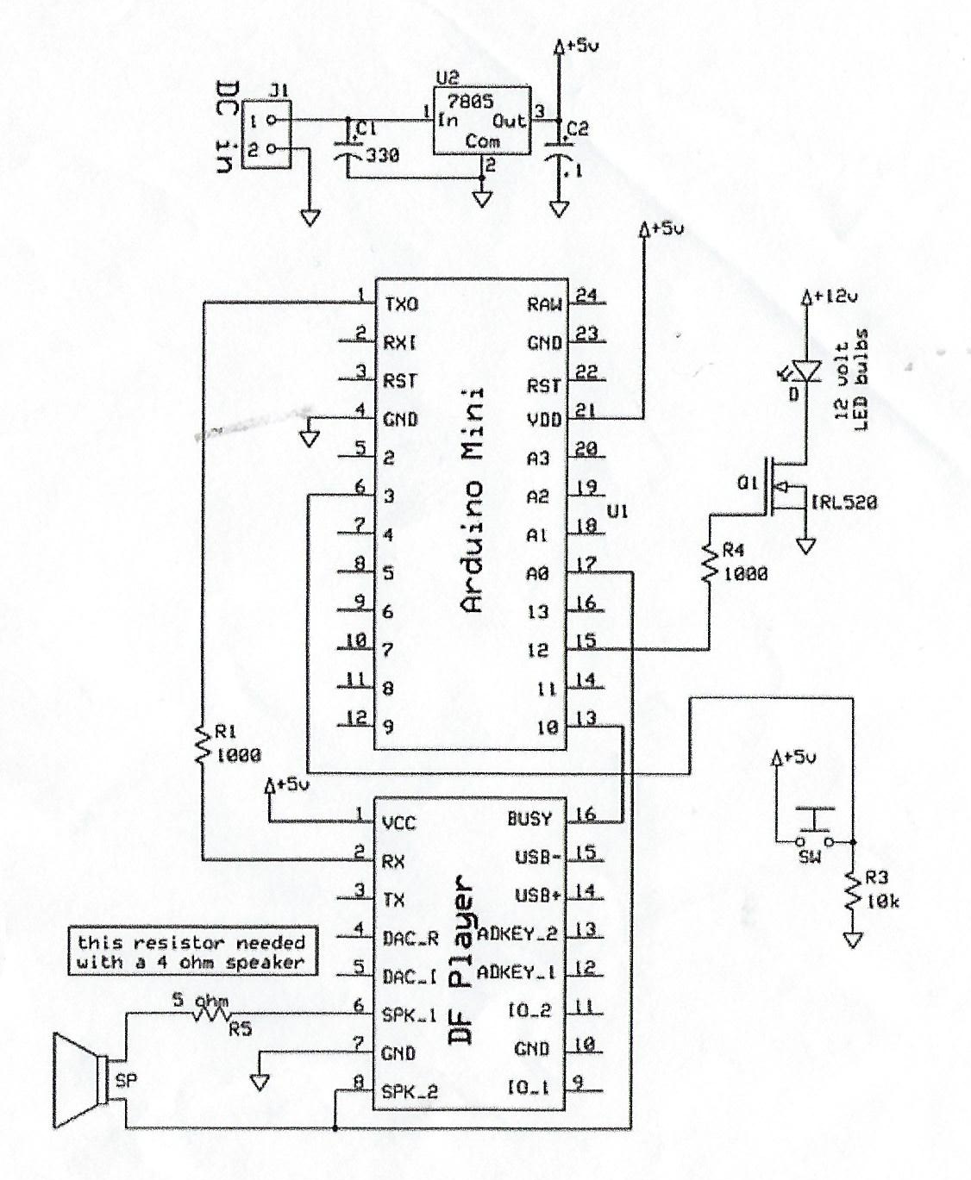
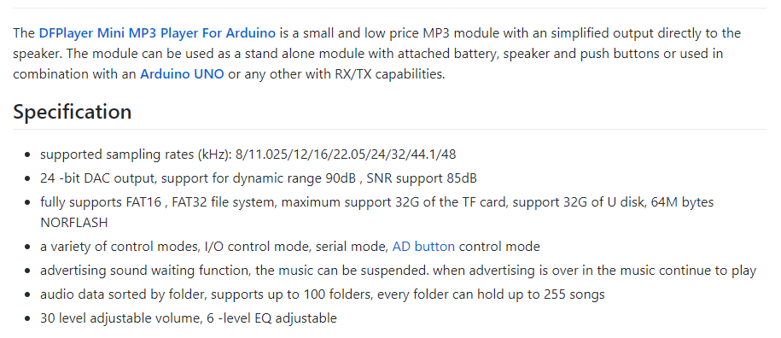
Circuit Design
Audio Out

Slide 7
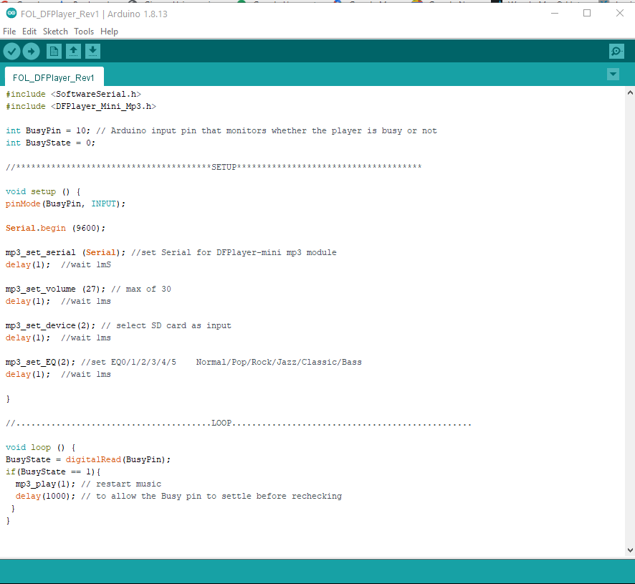
Software

Slide 8
Theory of operation
MP3 file stored on TF Card/Micro SD
TF Card inserted into DFPlayer Mini
Arduino Nano
Initializes DFPlayer Mini music player using serial interface
Waits until DFPlayer Mini is Not Busy
Then restarts music using serial interface
Notes:
Single MP3 file
Box runs on 12v ; Regulated to 5v for Arduino; 1k resistor used to limit Tx

Slide 9
Music
All music must be in MP3 format
All music files stored at https://drive.google.com/drive/folders/1YRBtsyW5Qj3rGyeWWWs9fnZrS2q31ibl?usp=sharing
Just copy file to TF/Micro SD card (rename as necessary)

Slide 10
Jingle Bell Rock
https://drive.google.com/drive/folders/0B4cAR8jE9SuCeWpMb0tjUXBMV1E?usp=sharing

Slide 11
Jingle Bell Rock
Hardware
Software
Lighting
Boxes
Overheads
Pneumatics

Slide 12
Hardware
Display is 12 columns and 8 rows
Each column is driven by a single custom driver board
Overall control is from single Arduino board

Slide 13
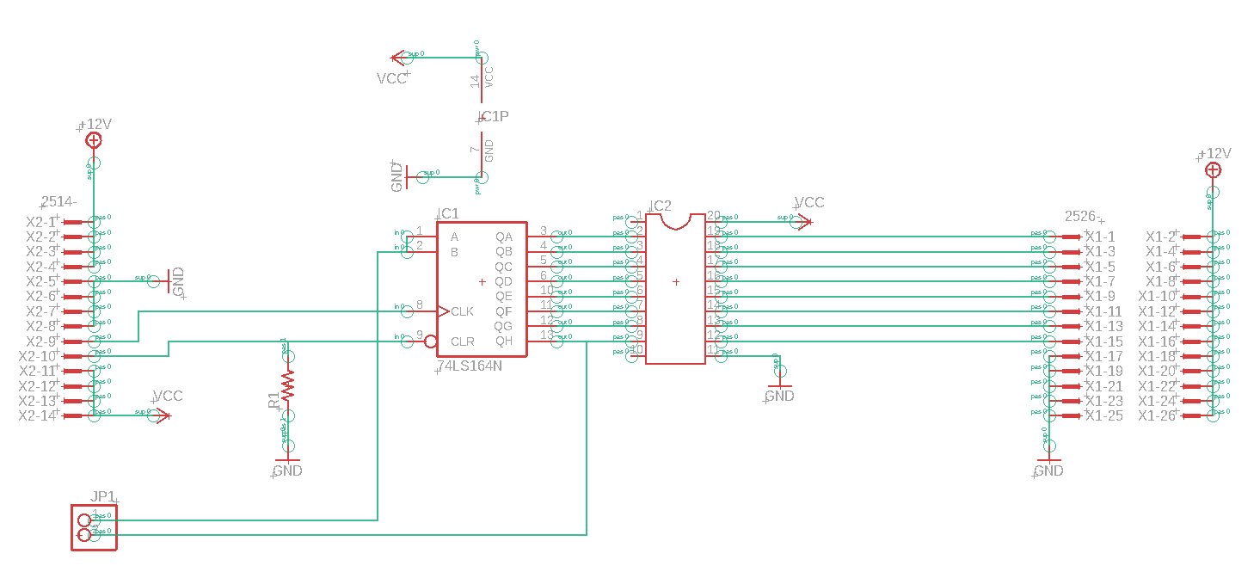
Custom Driver Board

Slide 14
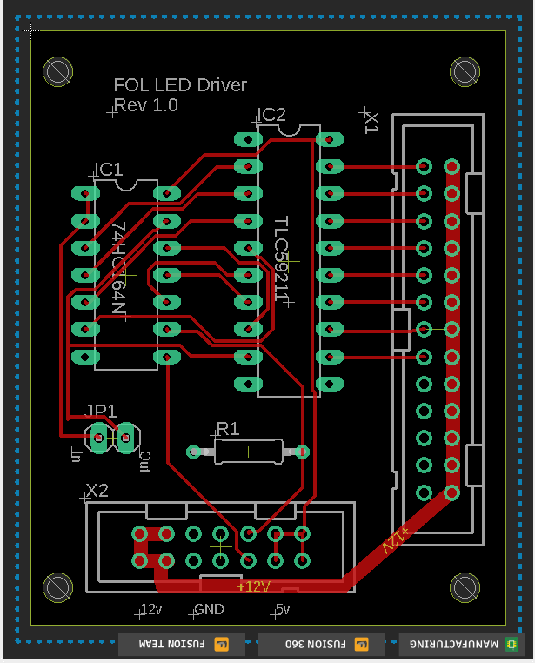
Board Layout
All CAD is in Eagle
All files are at https://drive.google.com/drive/folders/17efMtp1bh-j9D9nAtmnYIbDMgi13Wgm8?usp=sharing

Slide 15
Theory of Operation
Each PCB has 8 open collector outputs that drive the LEDs (8 Channel IC TLC59211)
Each of the cells in the display boards has LEDs that are connected to Vcc
To illuminate the LED, the open collector output is driven low
Each PCB has an 8 bit serial shift register
Data is fed to the board from Arduino using a single data pin and a single clock pin
Each of the driver boards is daisy chained so that each bit of data is pushed all the way down all shift registers

Slide 16
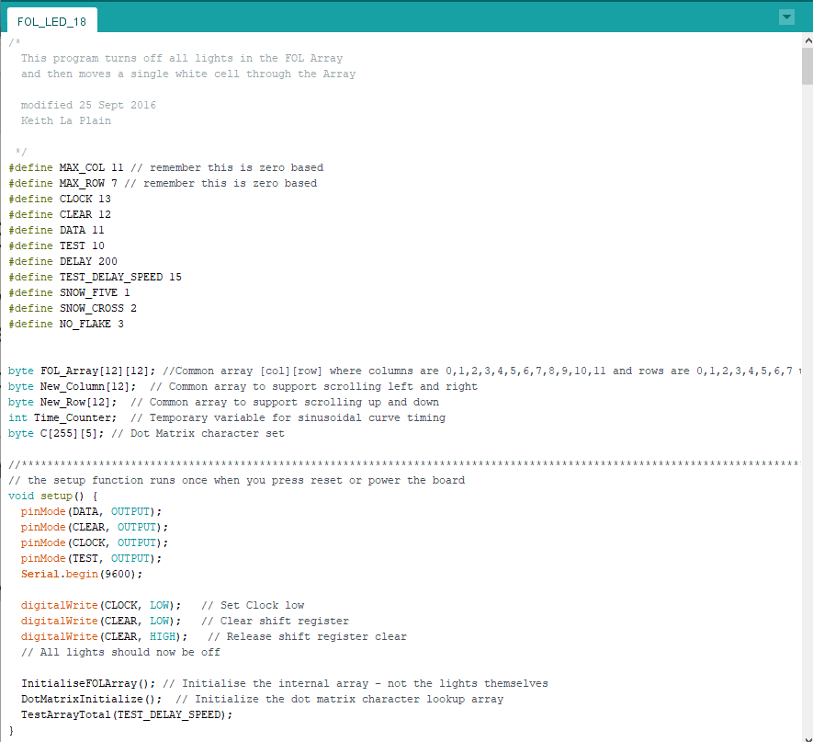
Software
All code is at https://drive.google.com/drive/folders/1uBSZQX1YDXt6i-stIYo7uj-wT9Z7c_Lm?usp=sharing
All software runs on Arduino

Slide 17
Software Notes
On Startup
Initialize all data and array lights
Test the total array to show pixels stuck ON or OFF
Cycling
Text Messages
Christmas trees
Snowflakes
Drizzle
Cycling for static parade
Assorted additional text messages

Slide 18
Things to note in software
The display is mimic’d with an software internal array; the whole array is then pushed to the physical display
Bits must be pushed as rapidly as possible to reduce flicker
Functions are available to scroll Left, Right, Up and Down
Characters are “drawn” using a dot matrix character set – static data in program
FOL_LED_19.ino is the latest version

Slide 19
Lighting
Box Lighting
Cheap DMX lights triggered to change color based on sound input
Could be configured to change color under control on DMX Controller
Overhead lighting
Higher quality Chauvet lights
Set to maximum brightness
Could be configured to change color under control on DMX Controller

Slide 20
Pneumatics
Ron is the specialist
Valves are currently controlled from timed relays inside float
Timed Relays connected to valves using ribbon cable
Notes
Lighting driver board was designed to be able to drive relays if needed. Pinouts for ribbon cable matches ☺

Slide 21
DMX Ideas

Slide 22
DMX Concepts
DMX is the standard for lighting and sound control for theatrical and stage systems
DMX 512 is wired standard that uses 3 or 5 pin XLR connectors
E1.31 is new wireless standard

Slide 23
Potential Lighting solutions
Use Vixen Lights on PC to create schedule/program of synchronized music, lights and motion
Download program to Falcon Player running on Raspberry Pi
Use Falcon/Raspberry Pi to control
Our DMX 512 lights through a serial to DMX converter
E1.31 lighting strands wirelessly using ESPixel Pops
Our DMX 512 lights through a proprietary E1.31 converter
Pneumatic Motion through a serial to GPIO to driver board
Note: I have had a prototype version of this already working

Slide 24
Revision 2.0
DMX
3 Pin
Par
Light
DMX
3 Pin
CN
Light
20v
Pneu
Act
Laptop PC
Vixen Lights
16 channel
Relay Board
DMX
Router
Pneu Driver Bd
Raspberry Pi 4 Model B
Arduino Mega
DMX Shield
Falcon Player
Falcon Player
Serial0
GPIO
192.168.0.9
GPIO
115200
Rx1
Serial1
Serial2
TTY AMA0
TXD GPIO14

Slide 25
Revision 2.0b
DMX
3 Pin
Par
Light
DMX
3 Pin
CN
Light
20v
Pneu
Act
Laptop PC
Vixen Lights
Router
Pneu Driver Bd
Raspberry Pi 4 Model B
Arduino Mega
DMX Shield
Falcon Player
Falcon Player
Serial0
GPIO
192.168.0.9
GPIO
115200
Rx1
Serial1
Serial2
TTY AMA0
TXD GPIO14

Slide 26


Slide 27
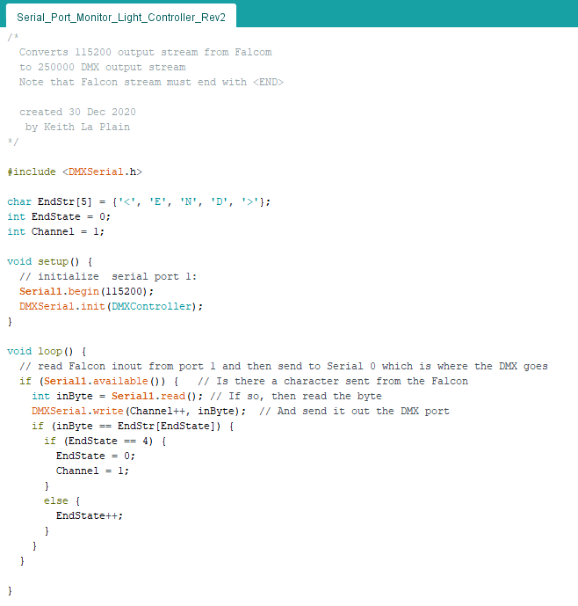

Slide 28
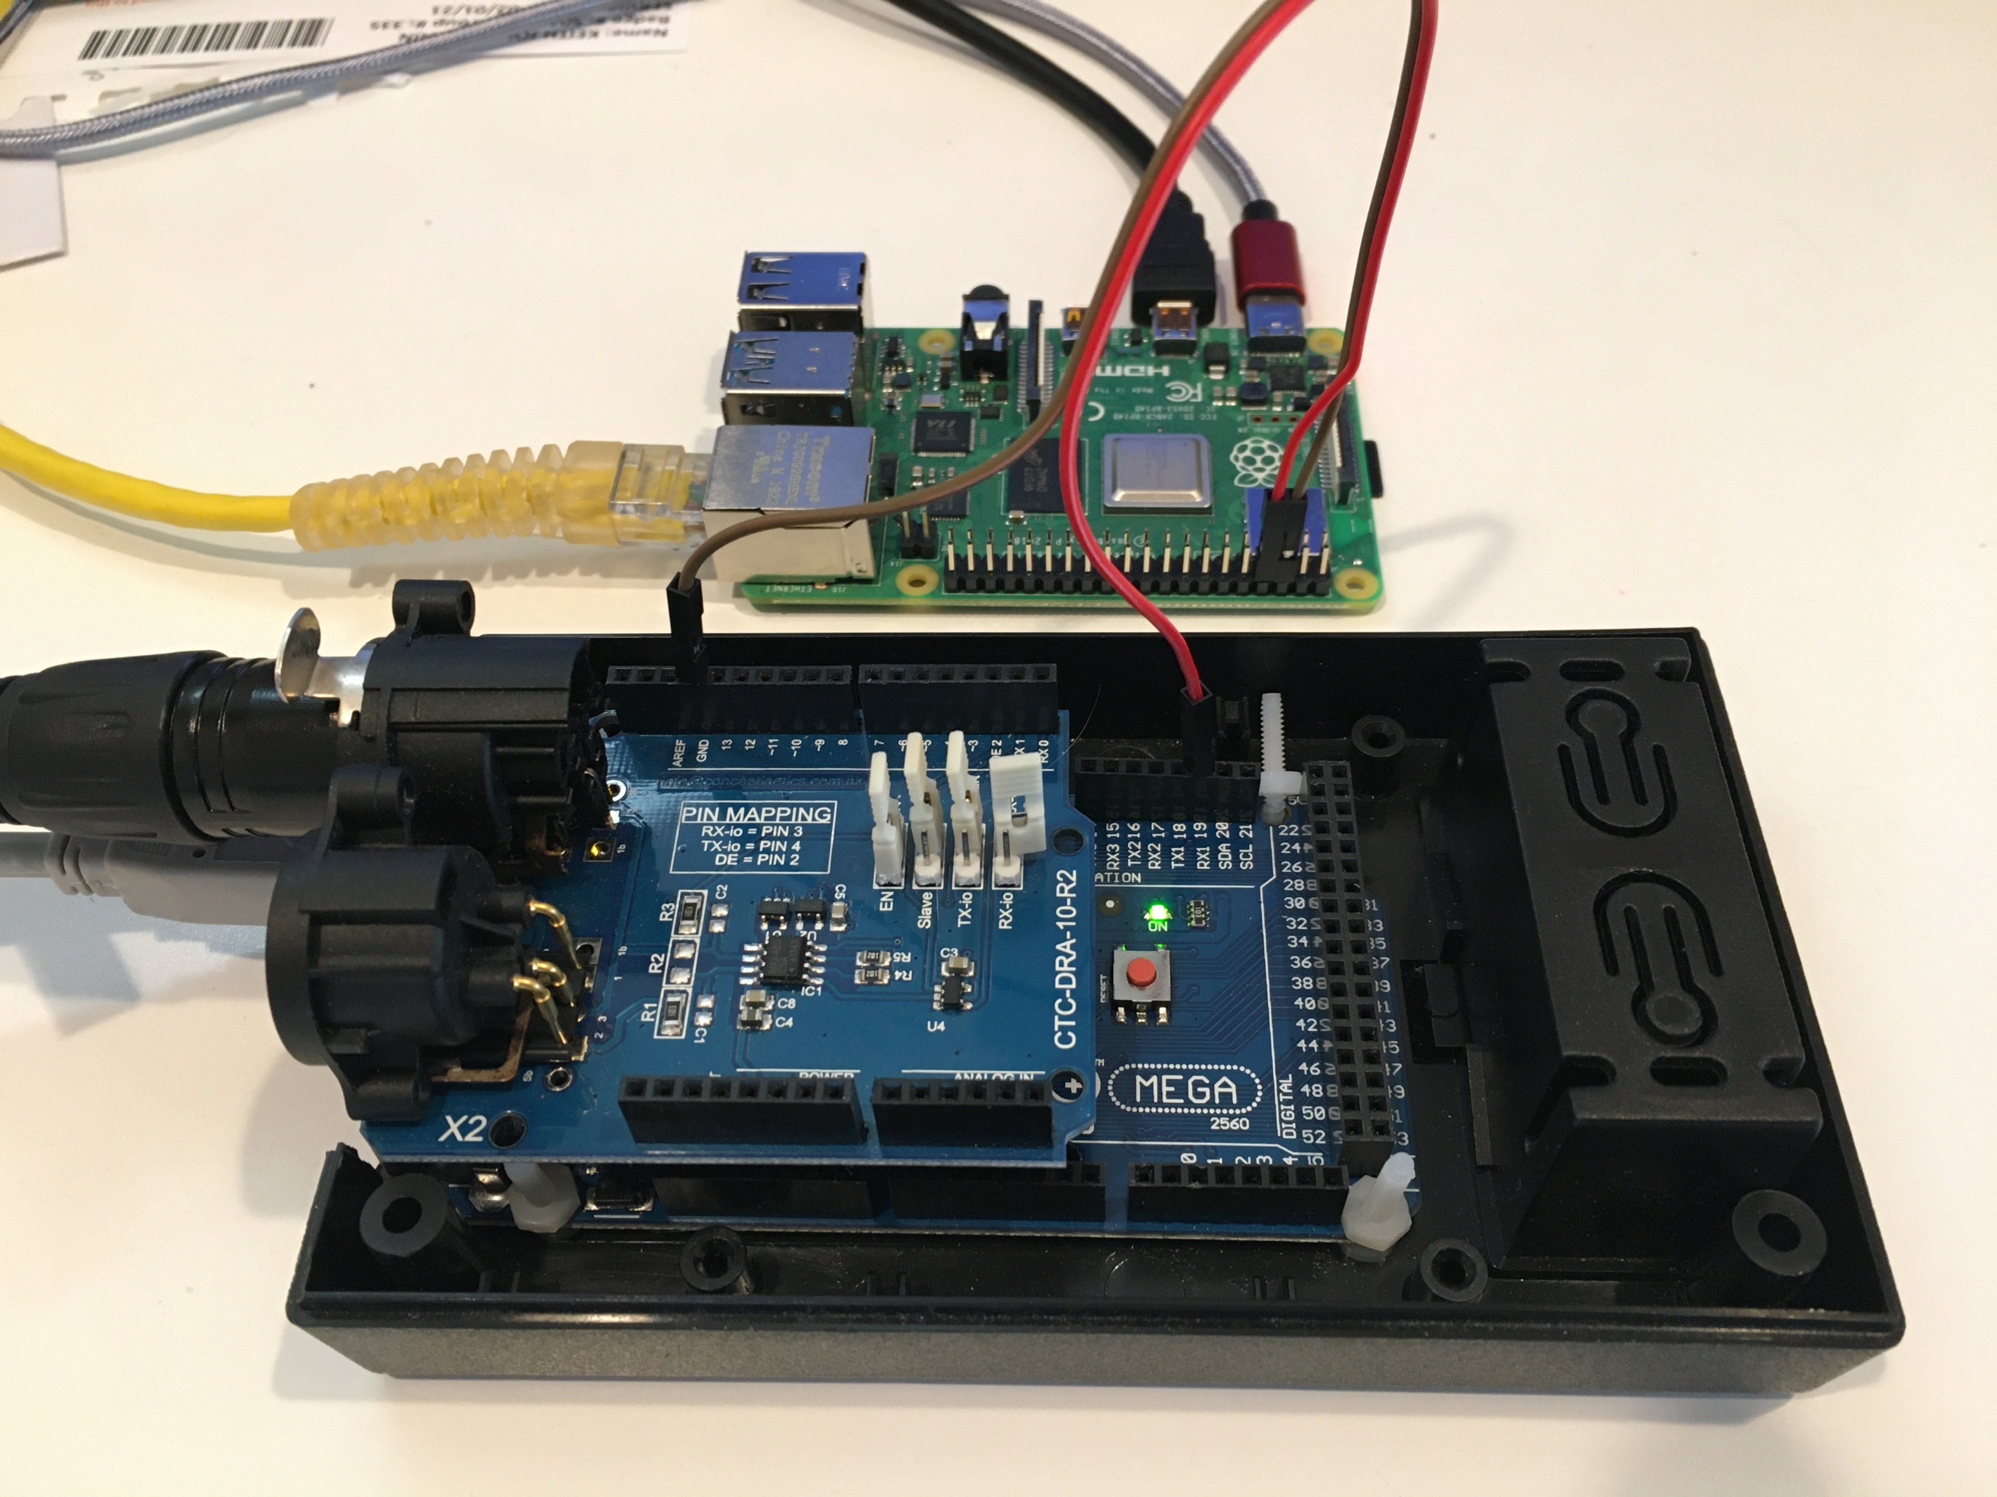
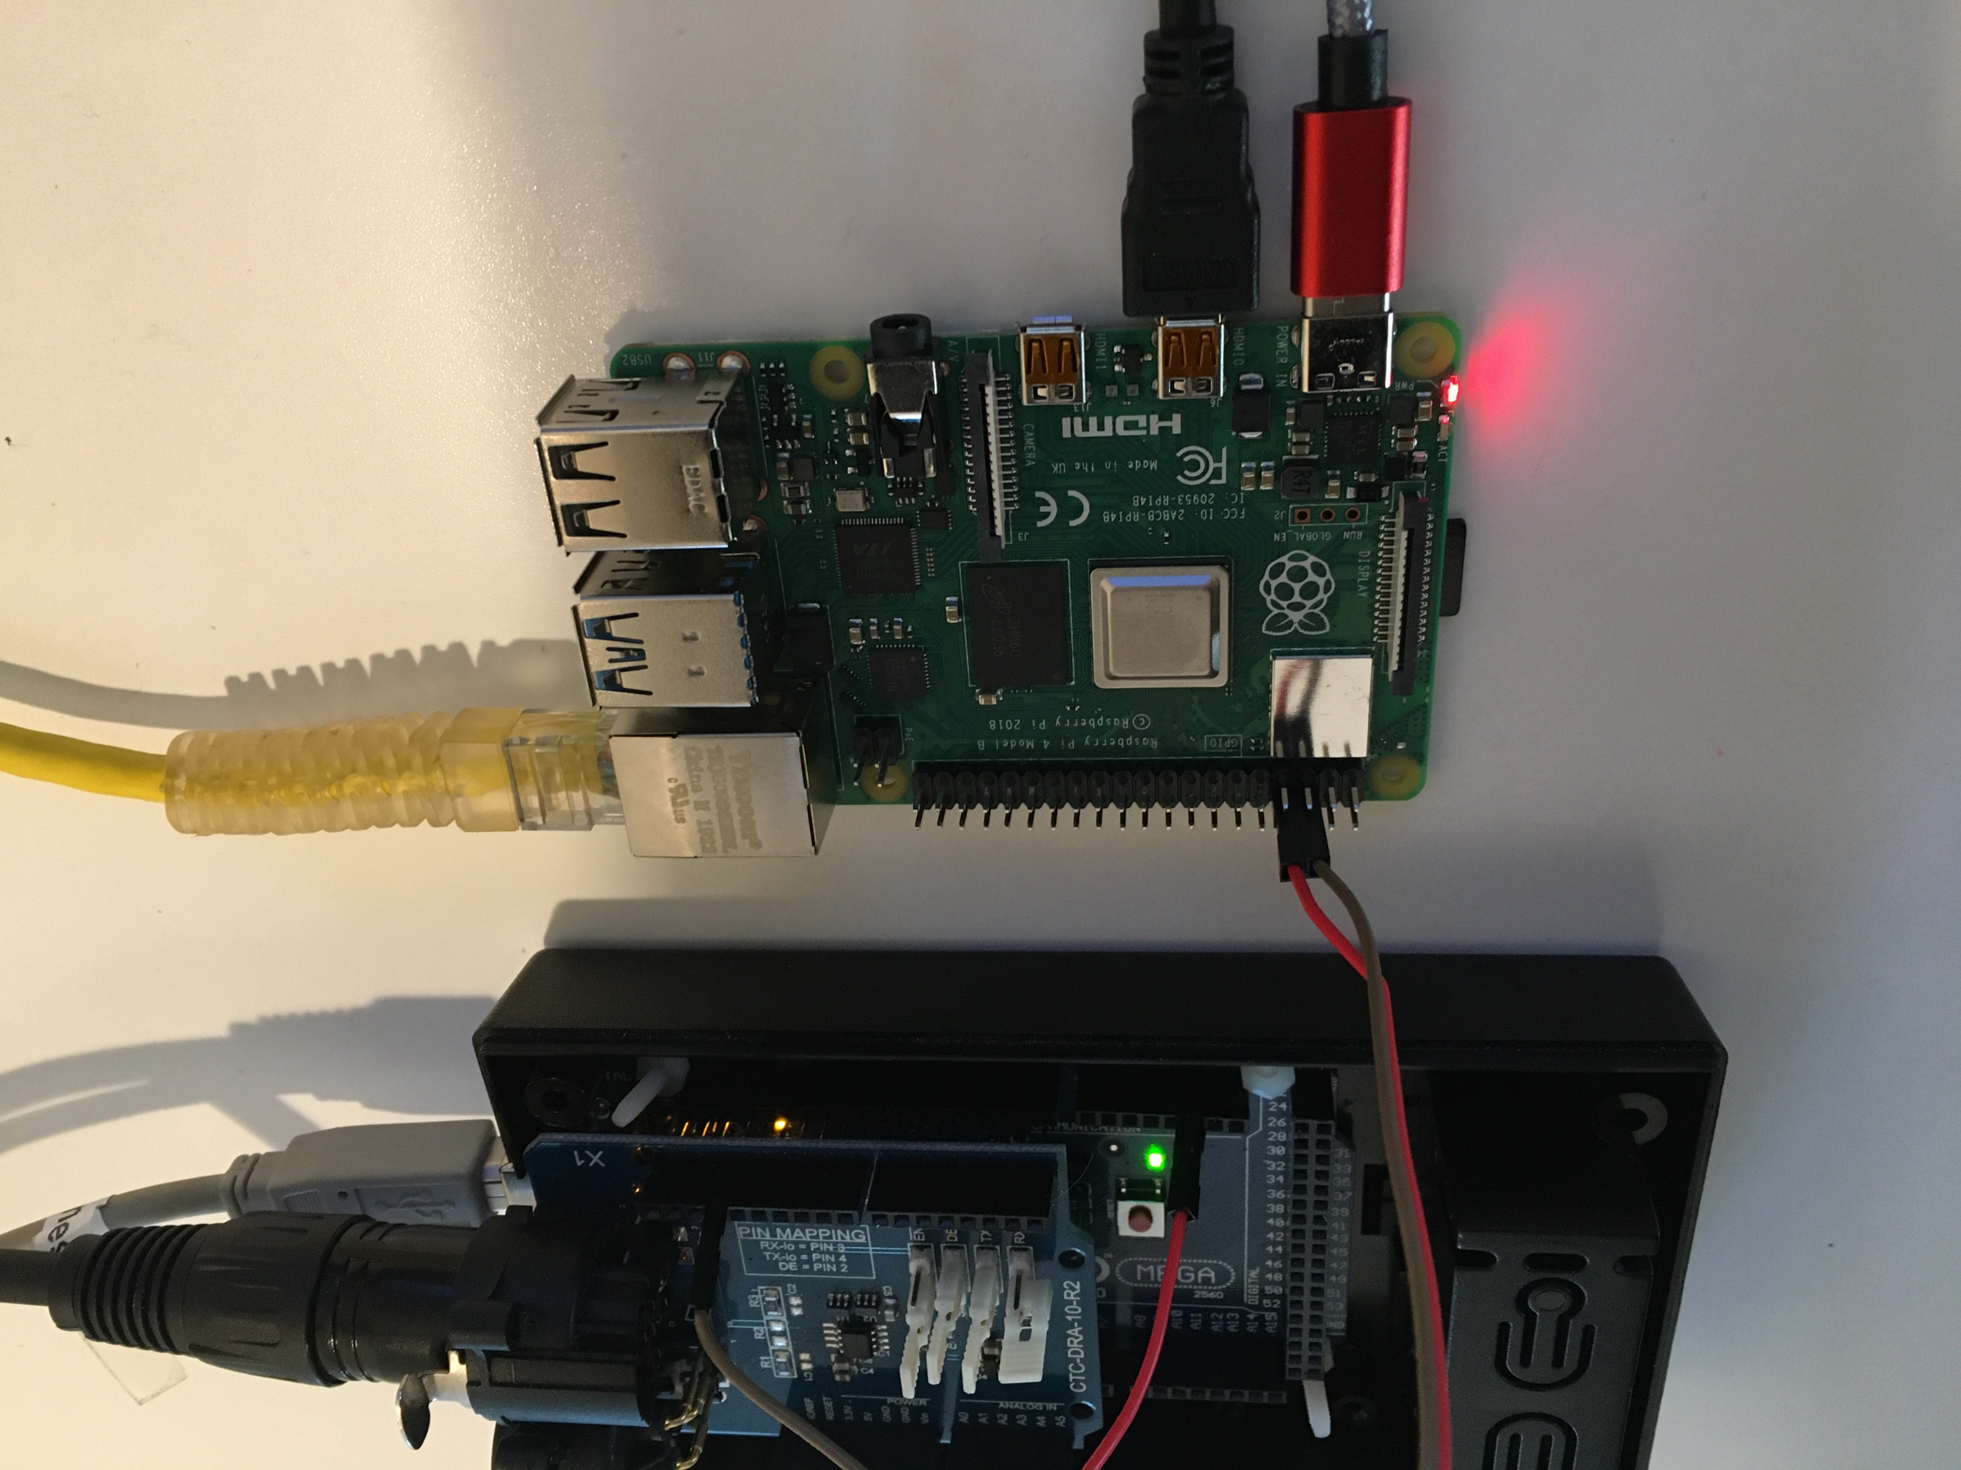
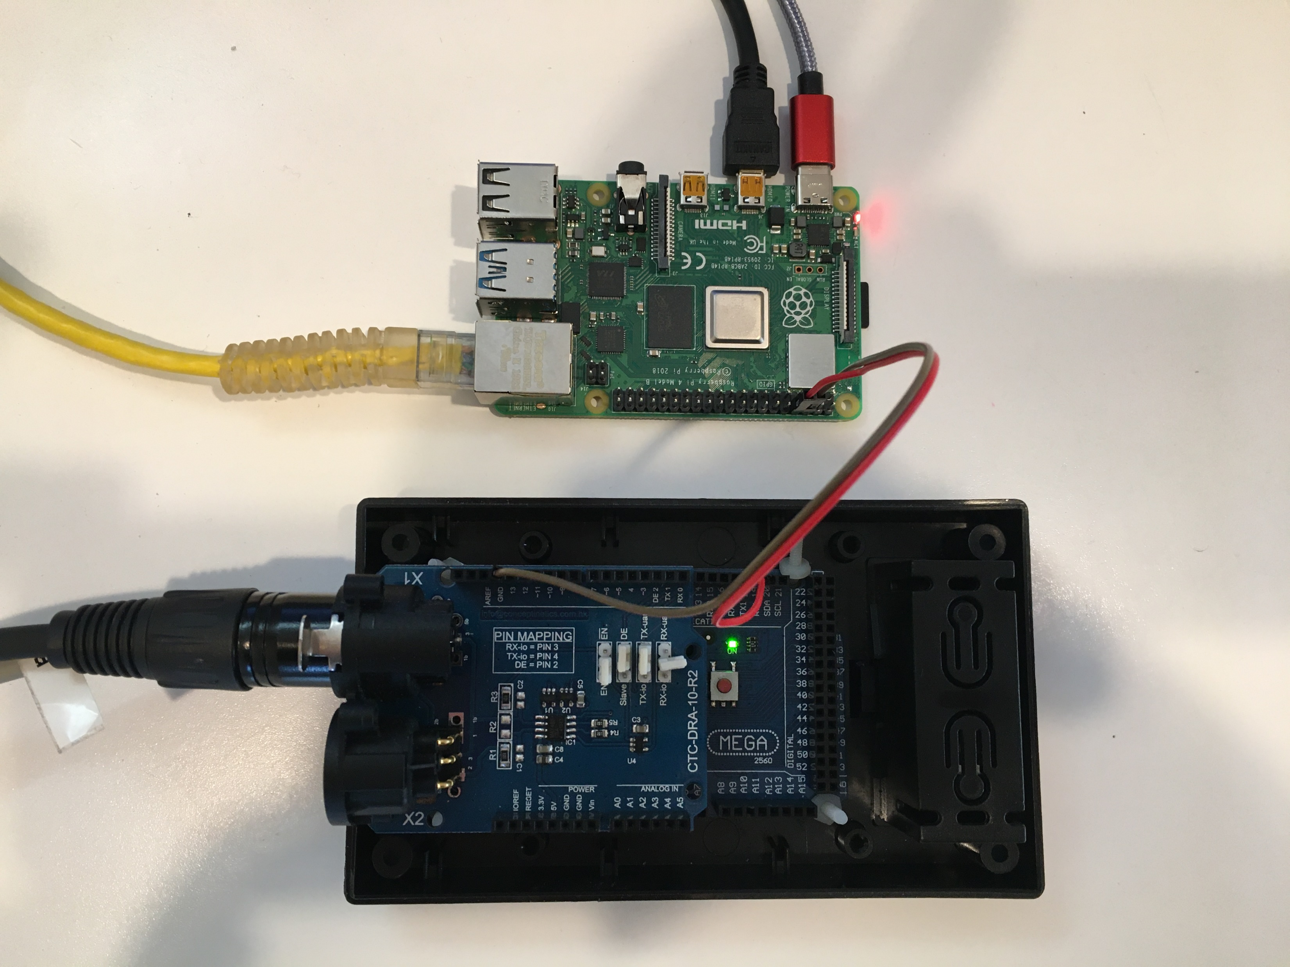

Slide 30
Vixen
Figure 1
PC Laptop
Amplifier
Solenoid a
Solenoid b
Connector
Solenoid c
Solenoid d
Sequencer
20v
Figure 2
Solenoid a
Falcon
Solenoid b
Connector
Solenoid c
DMX Relay Board
Solenoid d
Raspberry Pi
Figure 3
DMX Interface
Solenoid a
Solenoid b
Connector
Solenoid c
Solenoid d
DMX
Figure 4
Solenoid a
Solenoid b
Driver
Solenoid c
L1
L2
L3
L4
L5
Solenoid d

Slide 31
